Slide 1
Optimal Strain Sensor Placement Strategy for Deepwater Risers
Xuan Li
April 4, 2018

Slide 2
Outline
I. Background
II. FEM Modelling
III. Optimal Sensor Placement Strategy
IV. Discussion

Slide 3
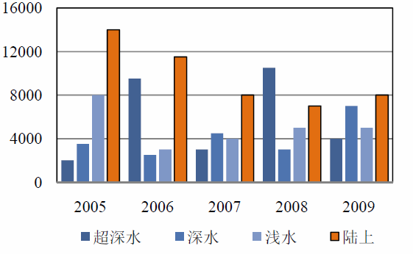

I.1 Research Need
Ocean contains 70% of the total oil and natural-gas on earth, and in 2015, 12% are drilled from deep water (>= 900m).
super-deep
deep
shallow
ground
Notes:
a tendency to go deeper

Slide 4
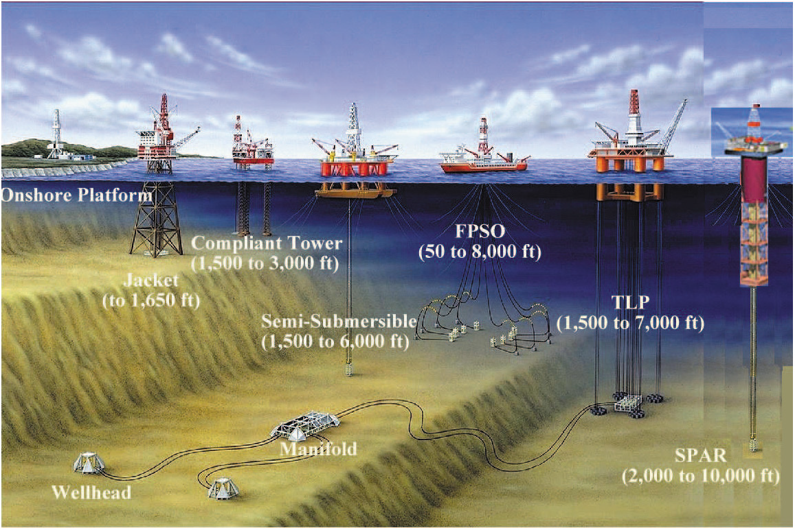
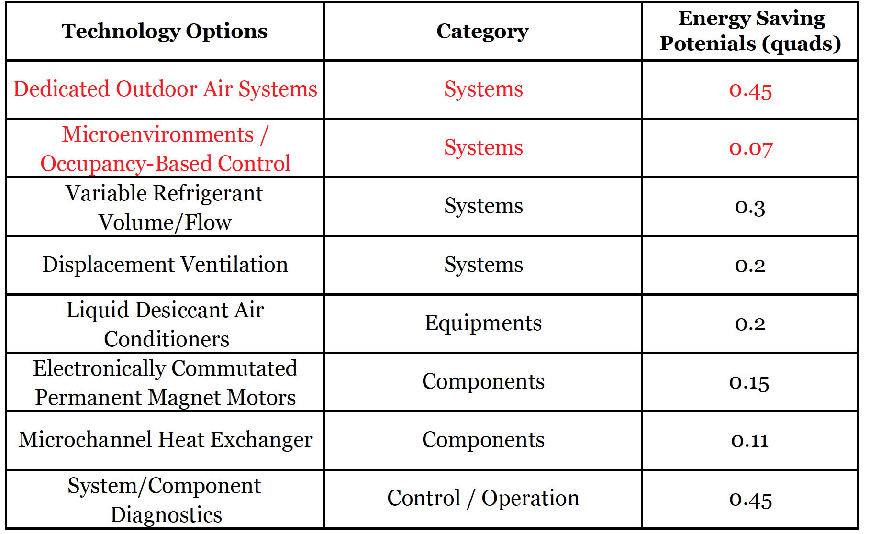
I.2 Types of Platform
Semi-submersible, tension-leg (TLP), SPAR, FPSO, etc
Notes:
a tendency to go deeper

Slide 5
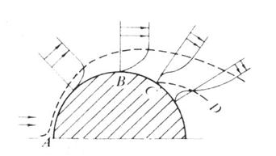
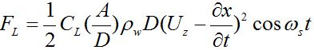
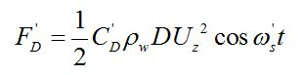
I.3 Vortex-induced Vibration: Mechanism
CF
U
IL
Notes:
Generate osciliating vortex:
Speed of flow is close to one of the natural frequency of the riser ; non-uniform flow rate around riser section → cause vortex

Slide 6
I.4 Vortex-induced Vibration: Damage on Risers
Time | Cause | Description | Leakage (Barrel)
2002 | VIV | Connection Failure from platform | 267
2003 | Storm | Breakage | 1421
2003 | Ocean current | Breakage due to fatigue | 74
2003 | VIV | Breakage due to fatigue | 137
2004 | Wave load | Connection Failure from platform | 48
2004 | Storm | Connection Failure from platform | 1034
2005 | Wave load | Connection Failure from platform | 426

Slide 7
II. Modelling: FEM
Notes:
x: in-flow
y: cross-flow
Variable: moment, displacement
Modular: beam

Slide 8
II. Modelling: FEM
Dynamic Equation
Cross-flow
In-flow

Slide 9
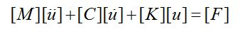
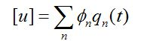
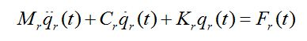
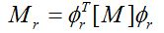
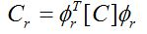
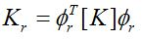
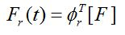
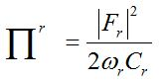
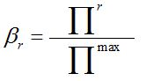
II. Modelling: Modal Analysis
Modal Analysis
Reduction Criterion (Modal Selection)

Slide 10
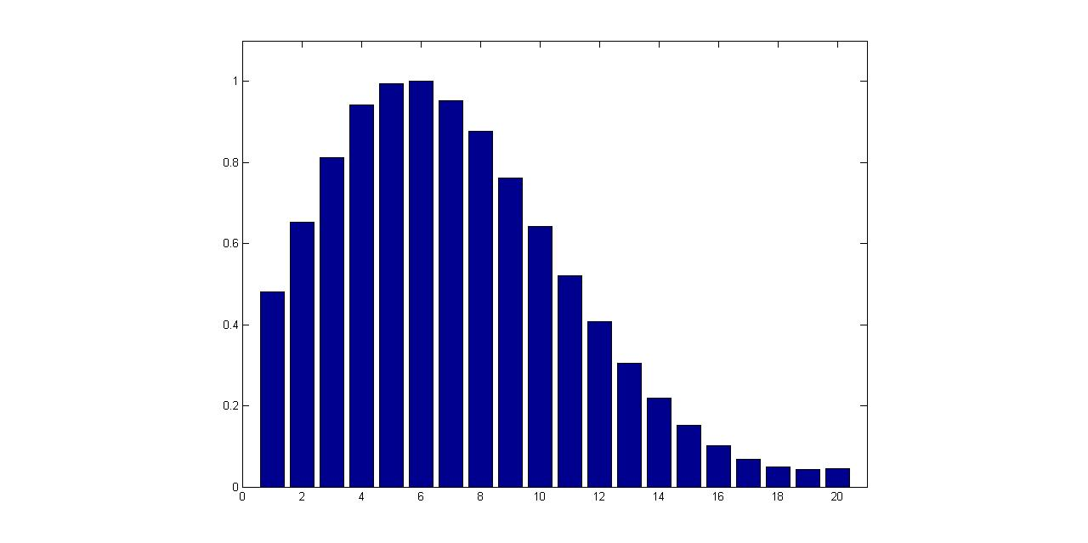
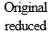
II. Modelling: Reduction
Reduction
Amplitude
Time
The relative motion energy of the first 20 mode for riser
The comparison between “reduced” and true model at 24m

Slide 11
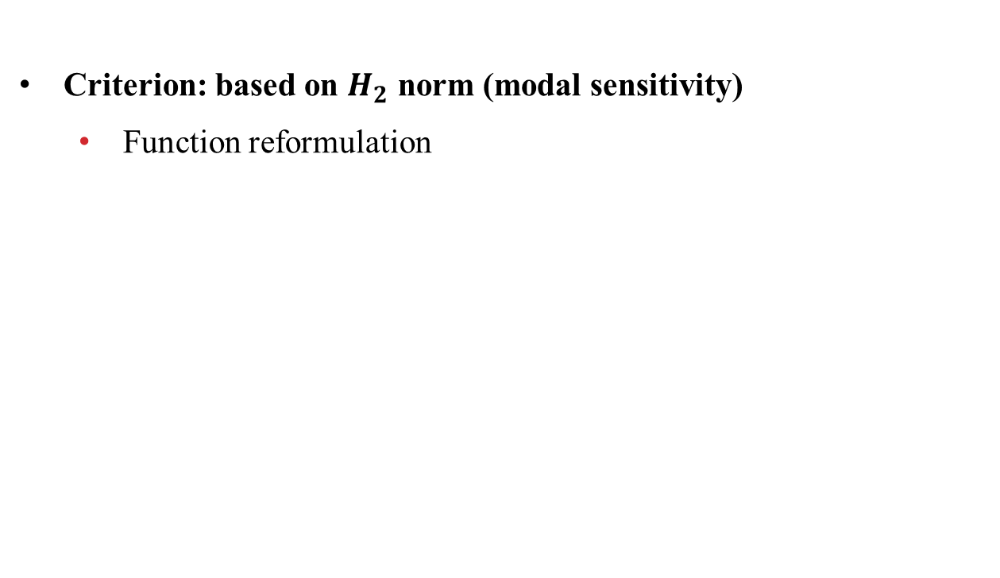
III. Optimal Strain Sensor Placement
Criterion: based on $H_{2}$ norm (modal sensitivity)
Function reformulation

Slide 12
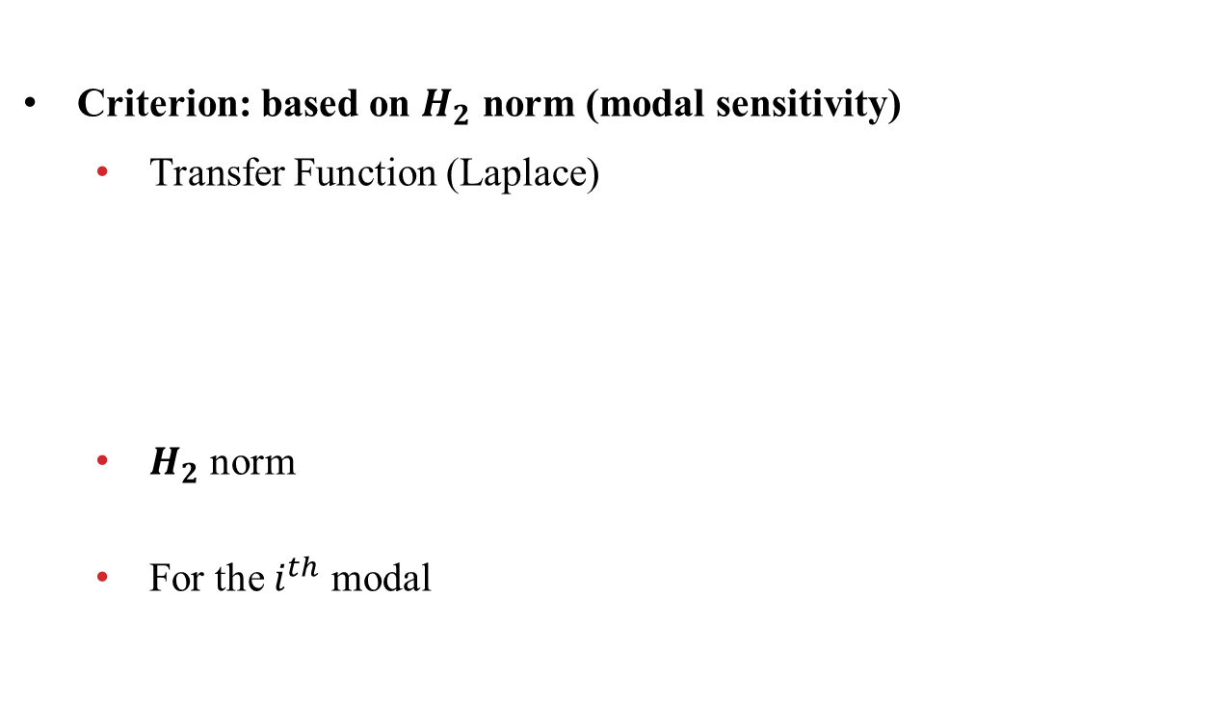
III. Optimal Strain Sensor Placement
Criterion: based on $H_{2}$ norm (modal sensitivity)
Transfer Function (Laplace)
$H_{2}$ norm
For the $i^{th}$ modal
Notes:
H2 norm measures the sensitivity of each candidate sensor location w.r.t. the excited modal

Slide 13


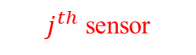
III. Optimal Strain Sensor Placement
Criterion: based on $H_{2}$ norm (modal sensitivity)
Optimal Selection Matrix
$j^{th}$ sensor
$i^{th}$ modal

Slide 14
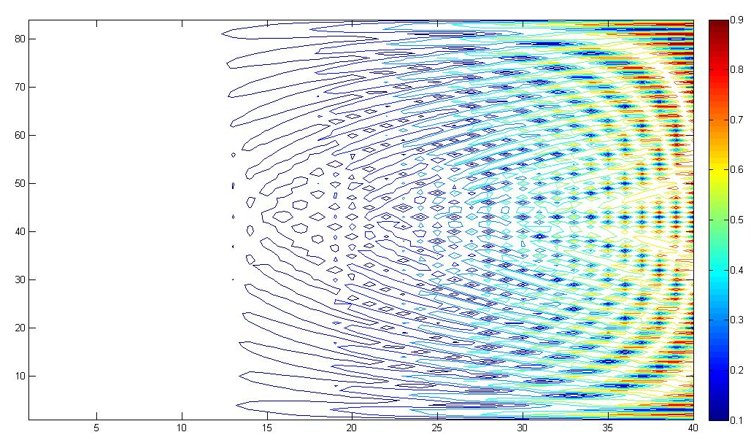
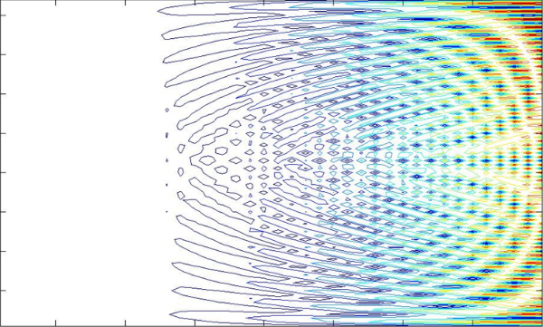
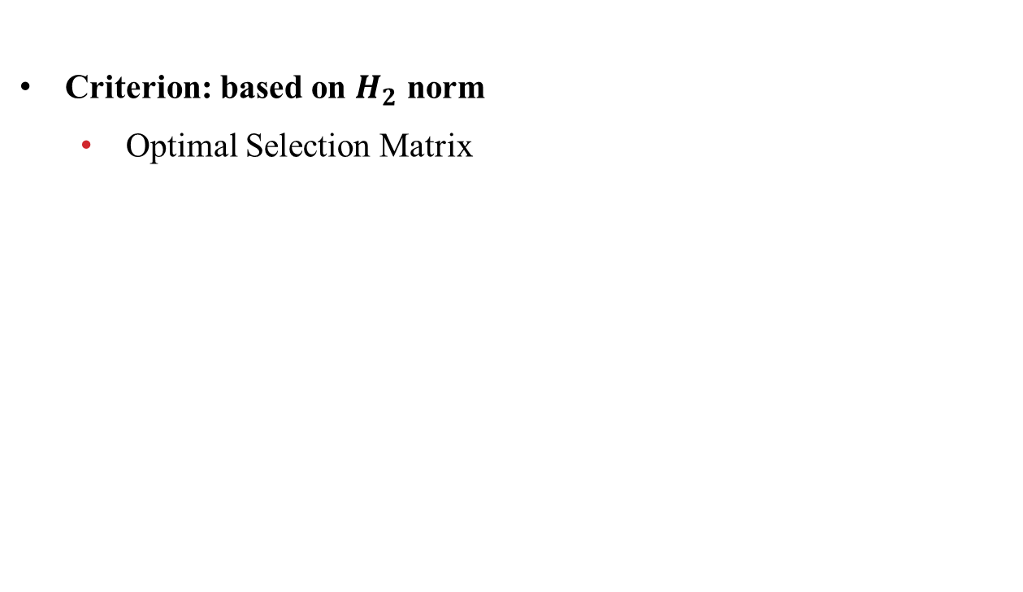
III. Optimal Strain Sensor Placement
Criterion: based on $H_{2}$ norm
Optimal Selection Matrix
sensor
modal

Slide 15
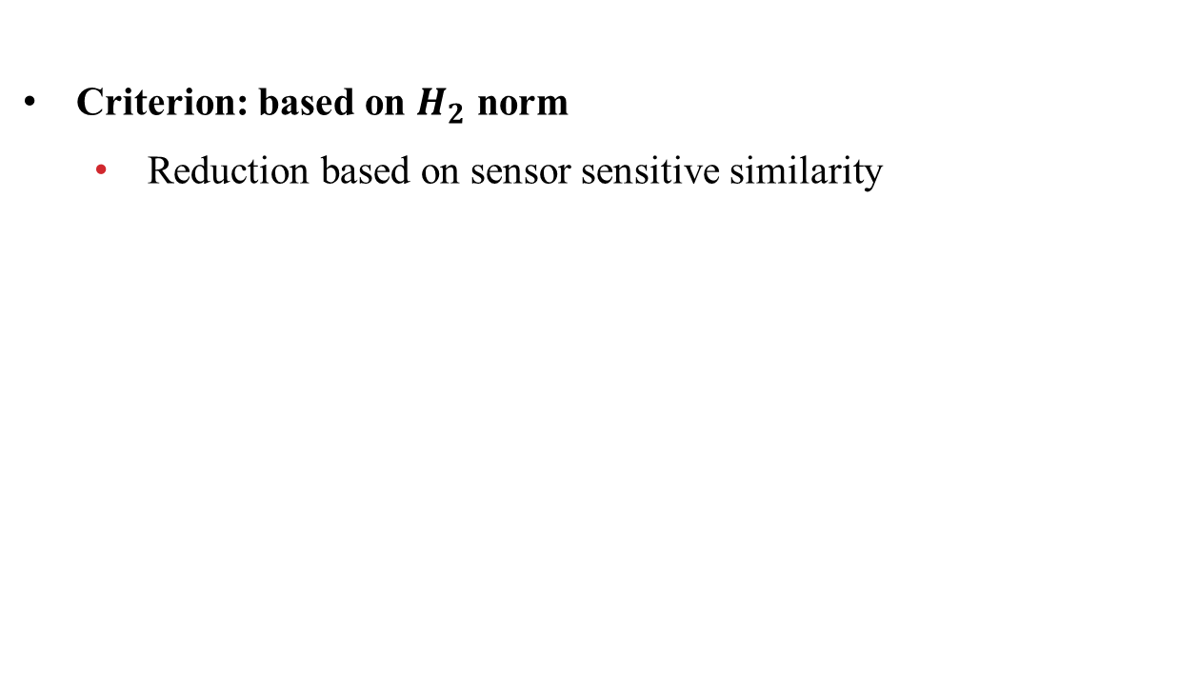
III. Optimal Strain Sensor Placement
Criterion: based on $H_{2}$ norm
Reduction based on sensor sensitive similarity

Slide 16
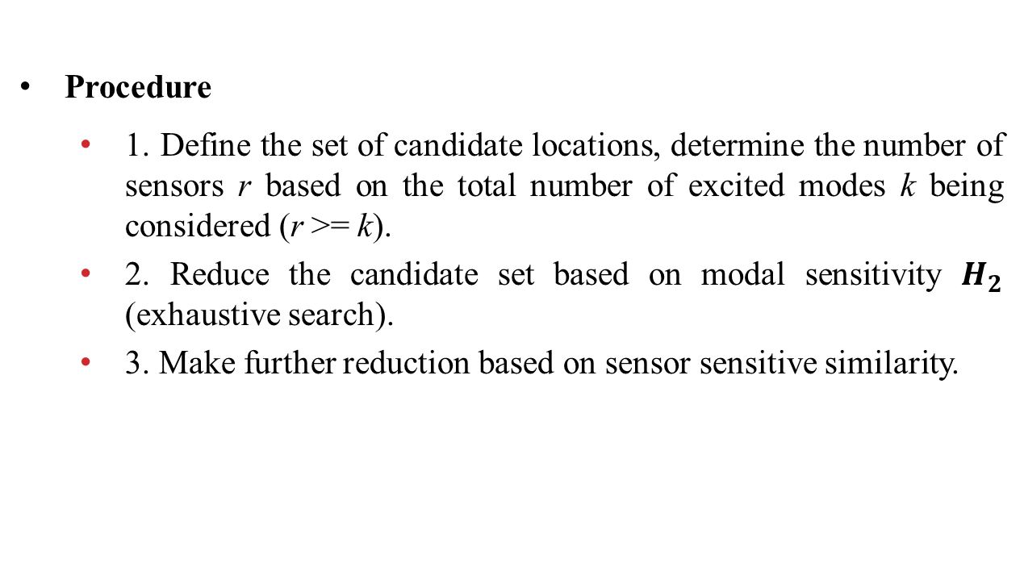
III. Optimal Strain Sensor Placement
Procedure
1. Define the set of candidate locations, determine the number of sensors r based on the total number of excited modes k being considered (r >= k).
2. Reduce the candidate set based on modal sensitivity $H_{2}$ (exhaustive search).
3. Make further reduction based on sensor sensitive similarity.

Slide 17
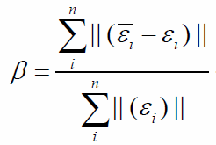
III. Optimal Strain Sensor Placement
Evaluation + Kalman Filter
Criterion

Slide 18
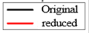

III. Optimal Strain Sensor Placement
Result
30 strain sensors:
[4,7,8,11,12,14,15,16,19,22,23,27,28,29,30,57,60,61,62,63,68,69,70,71,73,74,75,76,79,80]

Slide 19
III. Optimal Strain Sensor Placement
Result
Comparison
Comparison of accuracy between different sensor arrangement
 | Optimal | Case 1 | Case 2 | Case 3
β | 0.336 | 0.344 | 0.348 | 0.349
Comparison of accuracy between different number of optimal sensor arrangement
 | 30 | 32 | 34 | 36 | 38
β | 0.336 | 0.332 | 0.334 | 0.326 | 0.326

Slide 20

IV. Discussion
Sensor optimal placement + Kalman Filter
References
Li, X., Ren, P., Zhou, Z. and Ou, J. An optimized FBG-based fatigue monitoring strategy on deepwater risers. In Optical Metrology and Inspection for Industrial Applications III.
Bai, S., Li, X., Xie, Z., Zhou, Z. and Ou, J., 2014. A wireless fatigue monitoring system utilizing a bio-inspired tree ring data tracking technique. Sensors.

